Slide 1
Budgets, Acquisitions and Contracting – Some random Thoughts
Bob Marshall, MD MPH MISM FAAFP
Program Director, DoD/MAMC Clinical Informatics Fellowship

Slide 2
Objectives
Discuss bolt-on acquisitions
Discuss the effect of AI on contracting
Discuss the Gartner perspective on IT Budgeting
Review the government perspective on IT Budgeting

Slide 3
Bolt-on Acquisitions – Why Acquire?
There are all sorts of good reasons for one company to acquire another
It might be an earnings boost, where the post-acquisition company continues to operate independently while increasing the value of the parent company
It might be to take a competitor out of action – buy a company and then shut it down
It might be to buy talent
It might be to optimize the tax implications of new development
Or it might be to accelerate product development (and build out a richer product portfolio) by buying product capabilities across the market value chain

Slide 4
Bolt-on Acquisitions – Some Issues
Companies often see these capabilities as additive, that they can be “bolted-on” to current offerings to enhance the customer value proposition
What almost always gets underestimated, though – and often overlooked altogether – during due diligence is the actual integration of the new capabilities and how (or whether) it will work
This process has become doubly important in a digital world of seamless customer experience
Having a capability doesn’t automatically deliver the value of the capability, because it doesn’t recognize the interrelated aspects of experiencing the capability
Value comes from experience, and experience doesn’t happen in isolation on the value chain; it happens across the chain

Slide 5
Bolt-on Acquisitions – The Downside
You can’t just bolt new features on to your existing products and expect your customers to have positive experiences
At its best, the edges of the bolt-on will show; the transition from one to the other will be apparent, crude, and disruptive
At its worst, your customers will give up in frustration and go somewhere else
The customer experience “edges” of a poorly integrated product acquisition look and feel similar to when you, as a consumer, have to deal with different business units in a large company
These edges appear when artificial business constructs are dropped on top of human experience

Slide 6
Contracting and AI

Slide 7
Contracting and AI - Introduction
Contracting is a common activity, but it is one that few companies do efficiently or effectively
In fact, it has been estimated that inefficient contracting causes firms to lose between 5% to 40% of value on a given deal, depending on circumstances
But recent technological developments like artificial intelligence (AI) are now helping companies overcome many of the challenges to contracting
The main challenge firms face in contracting arises from the sheer number of contracts they must keep track of; these often lack uniformity and are difficult to organize, manage, and update
Most firms don’t have a database of all the information in their contracts – let alone an efficient way to extract all that data

Slide 8
What AI can bring to the Contracting Process
It requires a lot of manpower to draft, execute, and improve not only the contracts themselves, but also the contracting processes and the transactions these contracts govern
AI software, however, can easily extract data and clarify the content of contracts. (It could quickly pull and organize the renewal dates and renegotiation terms from any number of contracts.)
It can let companies review contracts more rapidly, organize and locate large amounts of contract data more easily, decrease the potential for contract disputes (and antagonistic contract negotiations), and increase the volume of contracts it is able to negotiate and execute
The use of AI contracting software has the potential to improve how all firms contract – and it will do so in three ways: by changing the tools firms use to contract, influencing the content of contracts, and affecting the processes by which firms contract

Slide 9
What AI can bring to the Contracting Process 1 of 6
While software for legal document review has existed for years, it typically only helps companies store and organize their contracts
AI contracting software can, for example, identify contract types (even in multiple languages) based on pattern recognition in how the document is drafted
Because AI contracting software trains its algorithm on a set of data (contracts) to recognize patterns and extract key variables (clauses, dates, parties, etc.), it allows a firm to manage its contracts more effectively because it knows – and can easily access – what is in each of them
AI software also offers simple prediction, which has implications for due diligence: AI contracting software can quickly sort through a large volume of contracts and flag individual contracts based on firm-specified criteria

Slide 10
What AI can bring to the Contracting Process 2 of 6
AI contracting software helps firms keep terms and usage consistent in all of their contracts
Being able to identify and extract key data points helps firms organize and execute contracts as well
Managing variations is a huge undertaking that requires proactive organization
But AI contracting software can record and standardize these provisions in the company’s contracts and in those that vendors send, making it far easier to identify instances of noncompliance and ensure that unfavorable provisions are dealt with promptly
AI contracting software can quickly assess risk in contracts (performing the risk analysis much faster than a team of lawyers) by identifying terms and clauses that are suboptimal
And it can reduce the risk of human error in contract drafting and review

Slide 11
What AI can bring to the Contracting Process 3 of 6
As new AI contracting tools change the actual content of contracts, this in turn affects the contracting
processes that firms use
Previously, successful contracting required skills in drafting and negotiating contracts, as well as in managing and reviewing them
Specialized high-value transactions were dependent on groups of attorneys devoting hours to comprehensive due diligence
Contracting professionals were expected to find clever ways to draft contracts to include clauses that favored their client
And even more routine transactions required employees to pay close attention to details

Slide 12
What AI can bring to the Contracting Process 4 of 6
But when most due diligence and contract organization – and even contract drafting – is done using AI contracting software, the resources required to produce a large volume of contracts, both simple and complex, will change
Lawyers will spend more time in assessing risk and providing counsel, rather than in document review
Instead of having a large team of associates conduct due diligence before a deal, companies will have a smaller, more agile team review the documents that the software flags and then offer advice
The role of contract management professionals will also shift

Slide 13
What AI can bring to the Contracting Process 5 of 6
Whereas contract compliance was previously done by an entire team, AI tools enable a well-designed software platform – coupled with a few employees – to do the job
Rather than organizational skills being key to the role, contract managers will need more technical and process flow expertise to work with the software
These improvements to tools, content, and processes will mean that contracting becomes faster, better, and easier once this technology is more widespread
But it is important to recognize that, while AI promises to do a lot, it won’t do everything

Slide 14
What AI can bring to the Contracting Process 6 of 6
Contracting technology is currently at a midpoint: One stream of development will be in industries with highly routinized, template-based contracts.
Here, AI contracting technology will be used in a blockchain model, allowing contracts to evolve and essentially re-write themselves according to the parties’ needs.
The other main use will be to help develop contracting standards, such as how to debate and structure certain clauses.
When companies negotiating a contract can easily access every similar contract from the past twenty years, prioritized by industry, and see what wording is most commonly used, we should see less onerous negotiating over clauses, leading to an easier contracting process

Slide 15
The Gartner IT Budget Four View Approach

Slide 16
IT Budgeting Challenges
IT budgets are often only created and managed with a single and narrow view of IT spending, driven by enterprise financial reporting imperatives and, thereby, limiting the transparency of IT costs and benefits
An increase in demand for IT projects and services with limited resources requires additional financial transparency to effectively balance the conflicting priorities of supply, demand, benefits and costs
The contribution IT makes to the enterprise is increasingly under scrutiny, so the value of IT needs to be demonstrated through multiple dynamic categorizations of financials

Slide 17
Asset-Based/General Ledger View
The asset-based or GL view is essentially the "IT budget" for most organizations
This view is typically the foundation from which all subsequent views are built
Getting this view right is essential
Without it, the remaining views are likely to be less useful and often inaccurate
Effectively managing the IT budget is "Job No. 1" from a financial perspective
It is a prerequisite for extending the focus beyond budgeting and into prioritization, IT planning and future capabilities
An inability to manage this view of IT spend can mire the CIO in continuous dialogue with the CFO and undermine IT’s credibility, thereby impeding the ability to demonstrate value

Slide 18
Investment View 1 of 2
The investment view divides both operating expenditure (opex) and capital expenditure (capex) into a view that distinguishes the amount of money (and potential value) spent on investing in new capabilities from the amount spent simply running the business
However, it is increasingly a source of confusion, because capex may be needed to refresh existing infrastructure and services, whereas new external services can now be purchased out of operating expenditure
Many CIOs opt for a simpler approach, such as "run the business" (RTB) versus "change the business" (CTB; see a simple example in Figure 3)
The key is to select a model that works best for your organization

Slide 19
Investment View 2 of 2
By overlooking growth, organizations try to drive down per-unit spending during periods of rising demand for IT services, but they also risk consuming the change budget, which should be dedicated to new strategic projects
As a result, the "change budget" view is often supplemented with IT investments categorized by the strategic planning or maxim pillars of the enterprise or IT organization
The details supporting the change view can also show how specific projects are progressing (such as on time, on budget and on quality)
The model used should be consistently applied to 100% of all IT spend to facilitate making the right investments that drive value for the enterprise, along with the ability to better predict or set targets to reduce run and increase the amount available for new investments

Slide 20
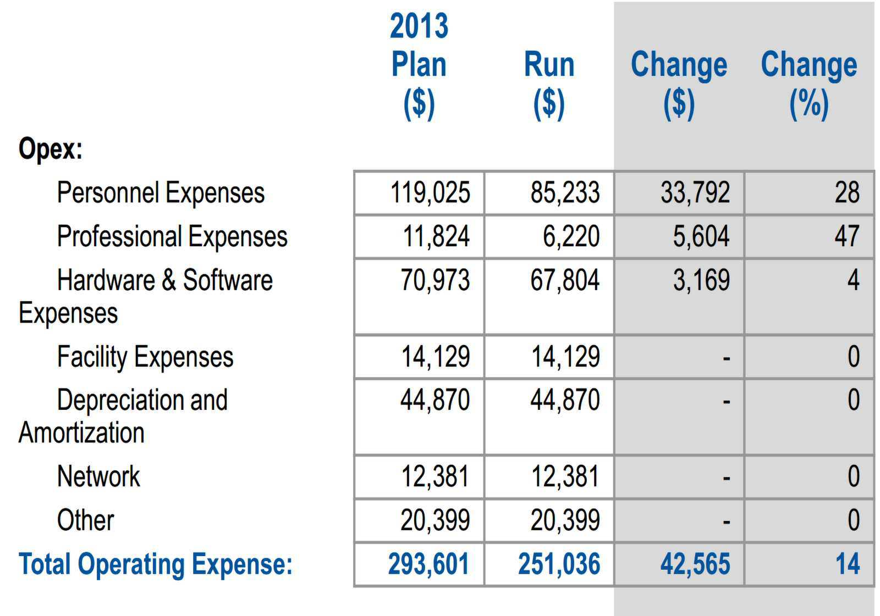

Slide 21
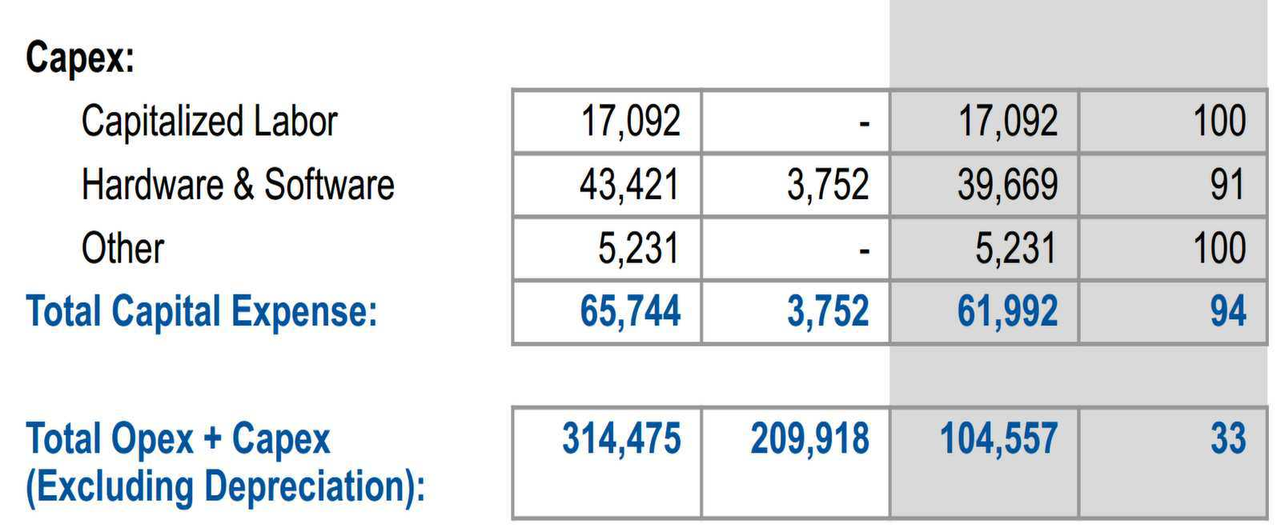

Slide 22
Technical View 1 of 2
Many organizations manage spend in technology stacks or domains
This allows for the effective management of IT spending in the language that most technologists and technology providers use
While the technical view provides additional financial transparency, the biggest benefit of this view comes from the ability to analyze and benchmark technology spending internally to minimize per-unit costs and to better manage the total cost of ownership (TCO) of each technology domain

Slide 23
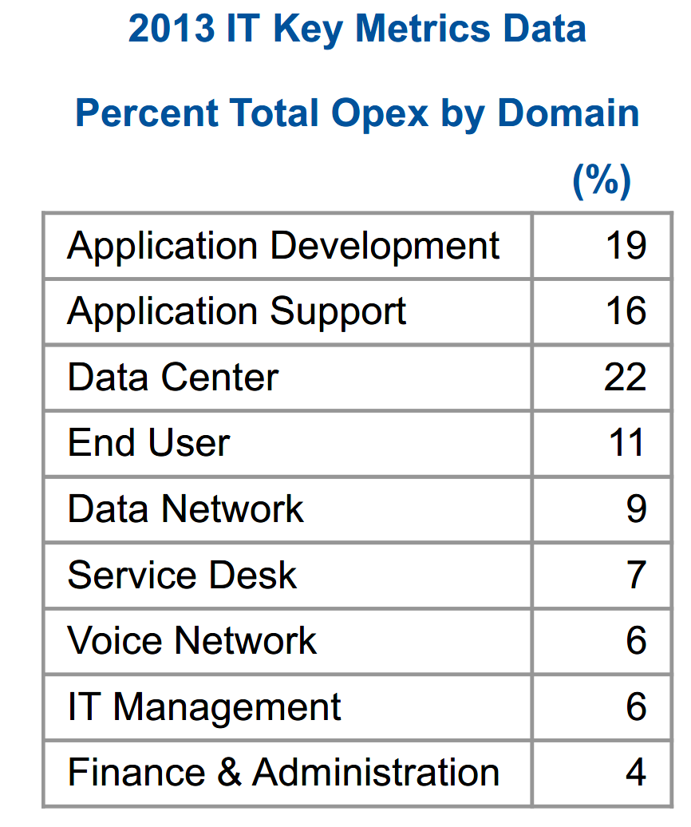

Slide 24
Technical View 2 of 2
Gartner's IT spending and staffing metrics and associated reports allow you to analyze your technology spend at multiple levels (for example, IT spend as a percentage of revenue or opex; IT spend by run, grow, transform; and IT opex by domain)
However, benchmarking is but one use of the technical view
Many IT organizations create cost models that go far beyond the items that are measured in Gartner's IT Key Metrics Database
These detailed costs are often custom-built to suit their particular environment so that costs are clearly understood and managed with IT
Also, the technical view of the budget can be used to calculate the cost of the IT business services in support of chargebacks

Slide 25
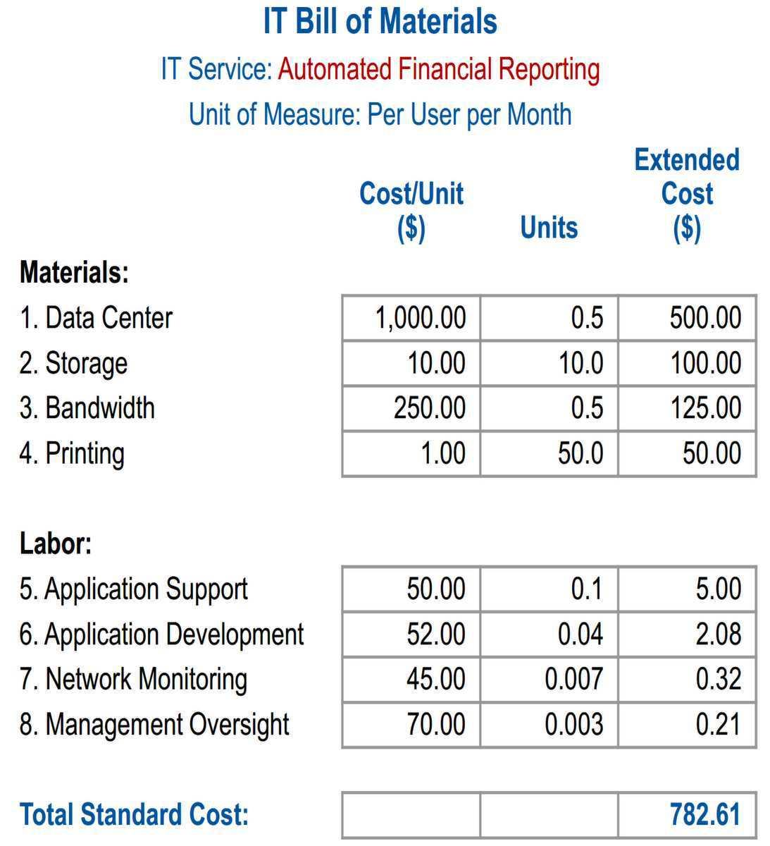

Slide 26
Business View 1 of 3
The business view takes the same operating costs as the technical view, but organizes them in a way that more clearly communicates the cost of the services IT provides in business terms (often, this is described as an IT business service or an IT-enabled business service)
This requires the creation of a service portfolio that lists a small set of services (typically less than 15) that can be costed and used to manage services provided to the enterprise
IT budgets should be presented using categories that make it easy for business executives to link IT expenses with business needs
How else can they judge the level of spending needed?
The answer is what Gartner calls the service-based view of the IT budget

Slide 27
Business View 2 of 3
The service-based view does not replace the asset-based view — it complements it
The service-based view should be regularly reconciled with the other views to ensure that IT spending remains on target
Variances that occur require investigation, and where justifiable, authorizations and adjustments should be made
IT service chargeback creates an opportunity to make this process more dynamic and responsive to business needs
Many organizations still tend to charge and communicate via technical services (that are part of the technical view outlined earlier), rather than communicate in terms the business understands

Slide 28
Business View 3 of 3
This business view can also help connect the consumption of IT services back to the asset-based view of IT budgets to help with better estimating
Often, a lone view by technical service or IT domain does little to effectively communicate the value IT delivers to the enterprise and often sends the message that IT does not understand the business
The real opportunity is to effectively integrate both the technical and business views so that the business understands the costs of services in terms it can understand, and IT can still manage the technical components and provide options to the business that help drive cost down

Slide 29
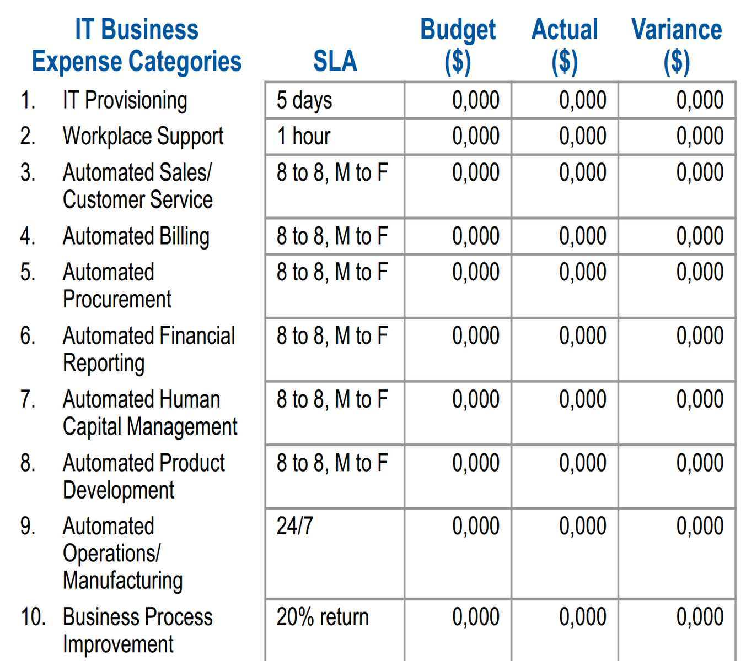

Slide 30
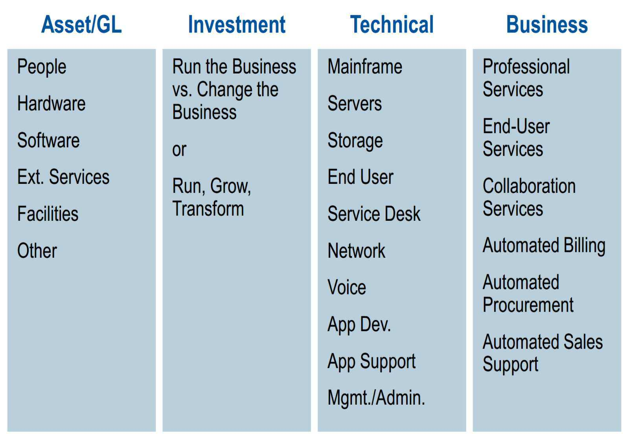

Slide 31
Budgeting – IT Budgeting – Gov’T Perspective

Slide 32
Budgeting is complex and important
Government budgets are complex due to fund accounting (for special-purpose allocations) and the large size of many government organizations
Government budgeting is also important because, lacking profits as a measure to safely empower decentralized decisions, governments allocate more of their resources through centralized budgets
Gartner recommends expanded analysis for budget planning (with trends for outputs and outcomes as well as general ledger (G/L) inputs, and with comparisons across internal units as well as against external benchmarks) and for budget control (with timely expenditure recognition so controls can be effective)

Slide 33
Innovation is more controversial
As in the private sector, expenditures to maintain existing operations are larger than, but ultimately not as important as, those to create more cost-effective operations
Although budgets need information about both, many fail to provide innovation-oriented views
This is especially true when leaders feel that innovation by stealth is more effective than by the public debate required for budgeting
Gartner recommends that, in some settings, CIOs should handle IT innovation via less visible techniques such as midyear reallocations, end-of-year surpluses unannounced in advance and/or grants from external providers
For governments and leaders truly committed to innovation, however, explicit budget analysis — often including innovations or R&D funds to make it easier to get "early mover" projects underway — is absolutely essential for effective results

Slide 34
Users given less control over IT spending 1 of 2
Who should make decisions on how much IT to use?
For innovations, choices may require analysis across and outside the organization, and depend on high-level decision makers
For routine IT services, however, knowledge is more likely to reside with users. In these cases, users who gain the benefits should bear the costs and make the decisions
As the four-views research suggests, user charges may be based on a technology-oriented bill of materials (usage of the data center, storage, network bandwidth) or, even better, on services where users can more easily see how IT services create value (support for IT provisioning, for the help desk, for business process improvement projects)

Slide 35
Users given less control over IT spending 2 of 2
Gartner recommends creating user fees with incentives to save so that resources can be reallocated to those activities — typically involving innovations — that add greater value for the public
The growth of cloud-based services will give users more of such "pay only for what you use" power
This will soon require internal (government) IT services providers to provide analysis that justifies their offerings in competition with external public- or private-sector providers

Slide 36
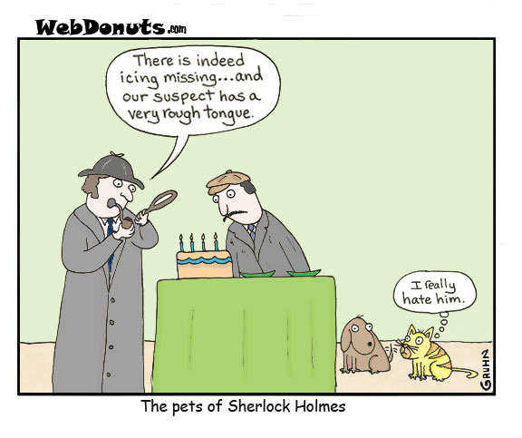
Questions

